Slide 1



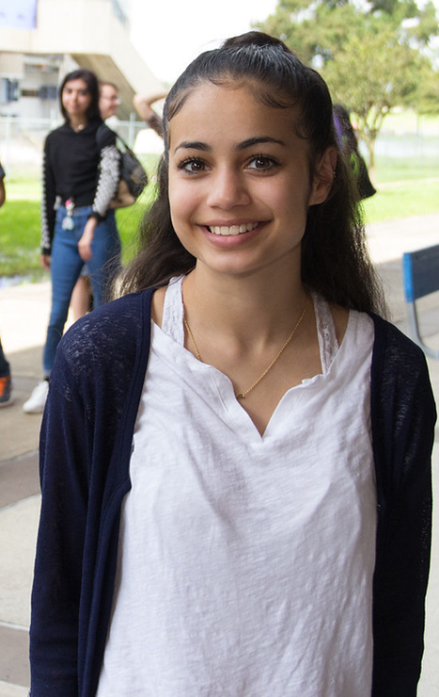
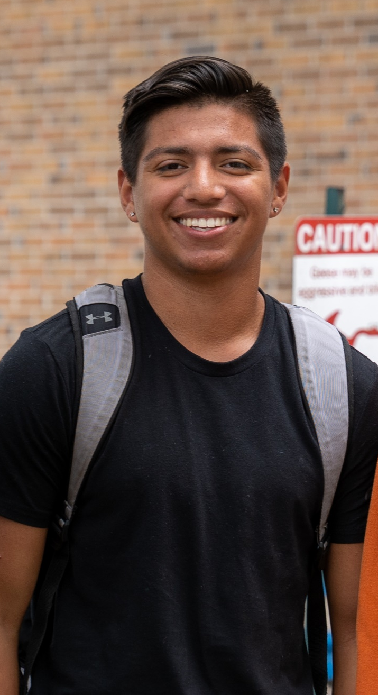
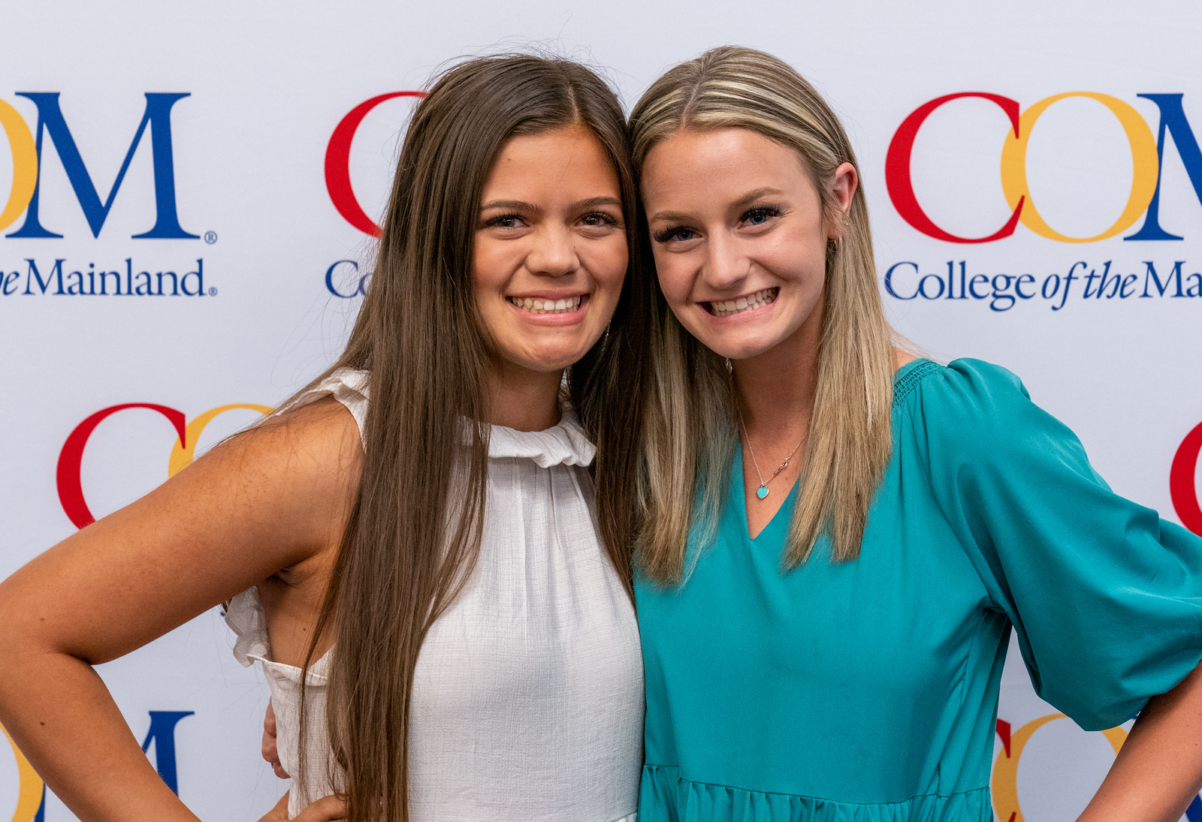
Collegiate High
School
Overview
February 8, 2024

Slide 2

Participating Local Education Agencies
  Clear Creek ISD
  Dickinson ISD
  Friendswood ISD
  Hitchcock ISD
  Odyssey Academy
  Santa Fe ISD
  Texas City ISD
Notes:
Not a fit for every student
Need to be mature, self-motivated
Grades matter-need C or better in every course to avoid future issues with financial aid

Slide 3
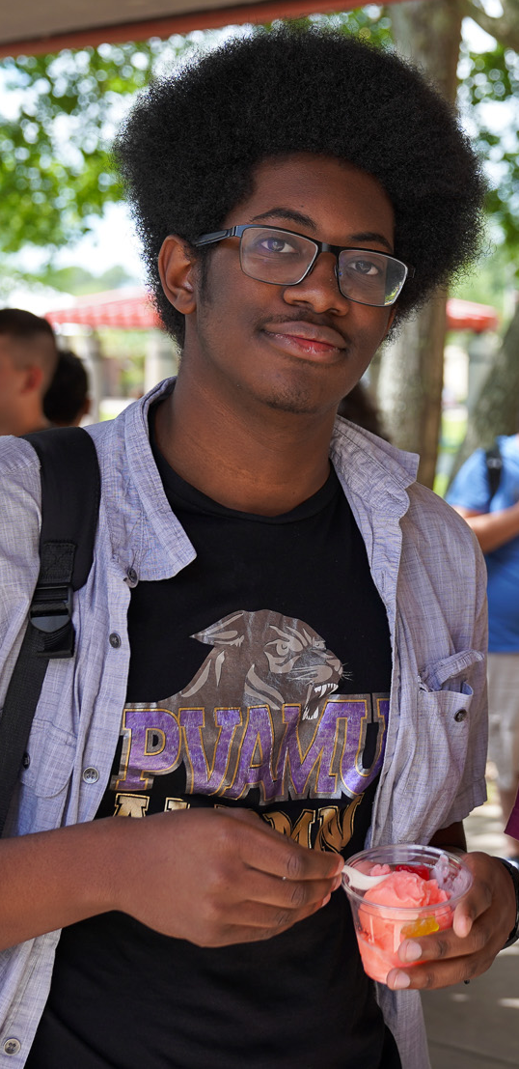
Mission
It is the mission of the Collegiate High School to prepare high school students to earn college credits in order to achieve their goals by providing a rigorous foundation of academic, interpersonal, and work-readiness skills, leading to further education and employment in high demand occupations in the state and global economies.
Notes:
welding-work toward Level I certificate
Cosmetology-eligible for State licensing exam
EMT-eligible to test for State licenses

Slide 4
CHS at a Glance
Target Students
Course
Load
Location
Goal
All classes are taken at College of the Mainland.
Participation in high school and college extra-curricular activities is encouraged.
Students who want the rigor and challenge of college courses, first generation college students, underserved student populations, and students from families of low socio-economic status.
All students will work towards high school graduation and associate degree requirements simultaneously.
Students are enrolled as full-time college students and take a minimum of 12 college hours a semester.
Notes:
Why take dual credit classes?
Explain each point
Emphasize savings on time and money.
Emphasize support of HS team.

Slide 5
CHS at a Glance
Student
Success
Age Level
Textbooks
CHS Banquet
Students may begin taking college classes as early as their ninth-grade year based on their school district’s policy.
Student Success classes provide students with activities to learn how to be successful in college and the workplace.
CHS maintains a textbook lending library.
CHS holds a yearly Graduation Banquet where students receive CHS cords to wear at their public high school graduation ceremony.
Notes:
Why take dual credit classes?
Explain each point
Emphasize savings on time and money.
Emphasize support of HS team.

Slide 6

Cost of Collegiate
High School
Collegiate High School students receive a tuition discount.
The college has adopted a new flat-rate tuition model effective Fall 2024. The cost for Collegiate High School students will be $31 per credit hour. A 12-credit hour semester will be approximately $372.
Notes:
Explain rates

Slide 7
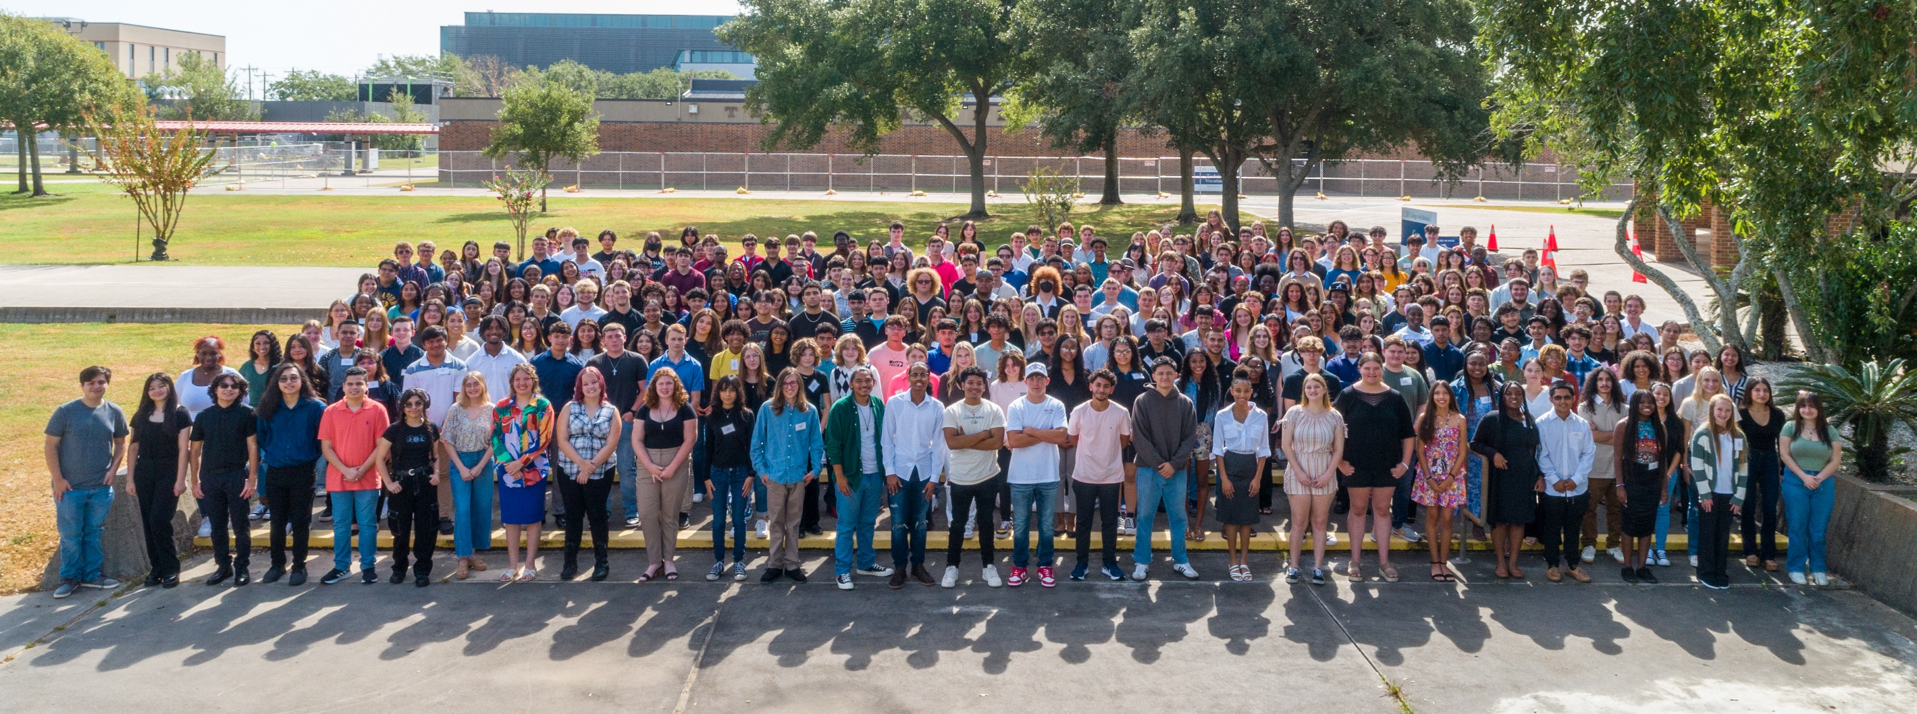
Admissions
Requirements
Junior or Senior Classification or permission from high school
Passing all state assessments
Prefer completion of Algebra I
College Ready
Notes:
Collegiate staff will present here.

Slide 8
Admissions Requirements
Student
Meet with high school counselor for school procedures
Complete online application for COM (ApplyTexas)
Pass the TSIA2 Assessment (ACT/SAT/PSAT/EOC)
      Prepare for TSIA2: https://tsia2.pearsonperspective.com
Complete CHS application (www.com.edu/chs)
Parents sign and complete recommendation form
Forward teacher, counselor and assistant principal recommendations
Write a personal essay
Submit completed application to your high school campus counselor or to the CHS office for private school students
Meningococcal Meningitis Vaccination required

Slide 9
Admissions Requirements
High School Counselor
Special needs or 504 documentation
Official transcript
Copies of Qualifying College Readiness Scores (needs to be official – see next slide)
Immunization Records
Review and approve completed applications
Forward to Collegiate High School
Collegiate High School
Review application (Date input): Test scores and immunization records submitted to Admissions. Admissions converts applicant to COM student. Then, CHS converts to a CHS student.
Student and parent interview
CHS Staff make the final decision.

Slide 10
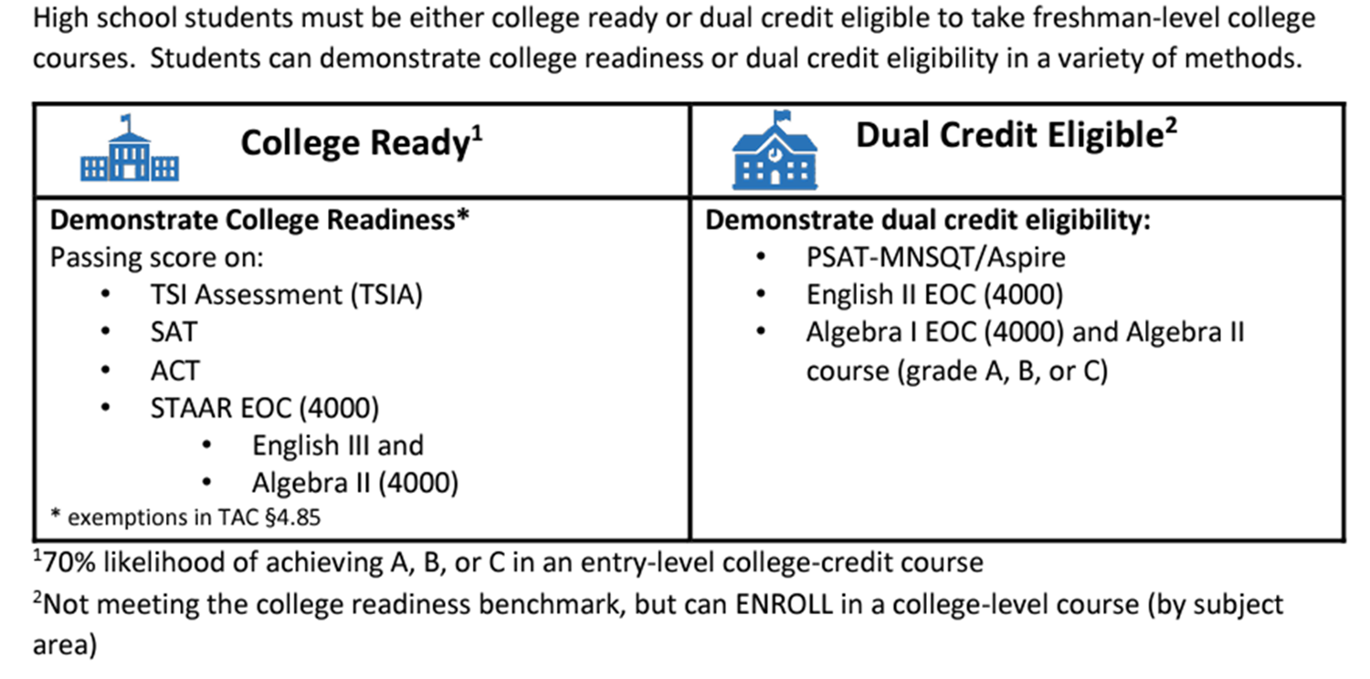
College Readiness

Slide 11
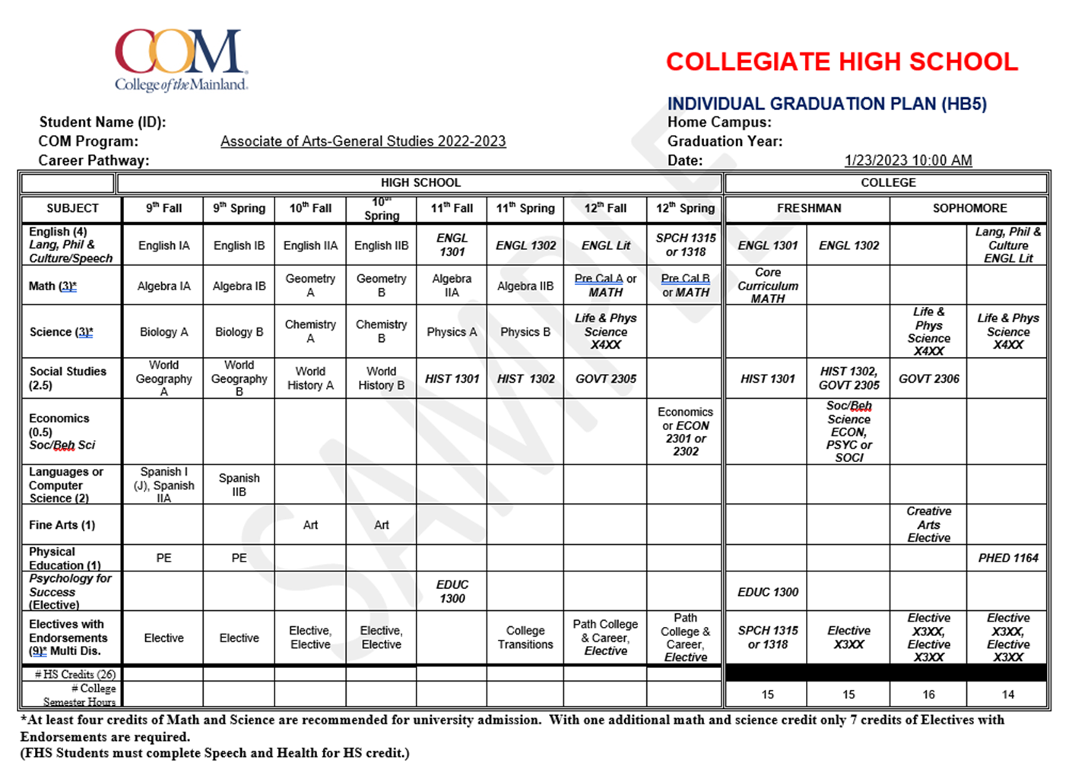
Sample
CHS
Graduation Plan
Notes:
Not a fit for every student
Need to be mature, self-motivated
Grades matter-need C or better in every course to avoid future issues with financial aid

Slide 12
Course Format
Beginning Fall 2024, COM will increase the number of
8-week courses.
  Most 3-hour courses will be 8 weeks.
  Most 4-hour courses will be 16 weeks.
  Most online courses will be 8 weeks.
CHS Staff are still working on what a typical CHS schedule will look like, where HS classes will fit in, etc.
Notes:
Explain topics
Emphasize importance of being prepared before class begins
Shift to HS presenter to talk about expectations

Slide 13
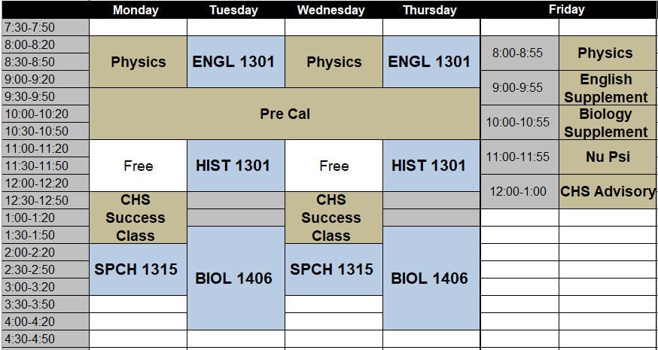
Sample of a Current Schedule
Notes:
Action items
submit interest form
choose classes
Apply Texas
Watch email for more info about testing, registration, payment and orientation

Slide 14
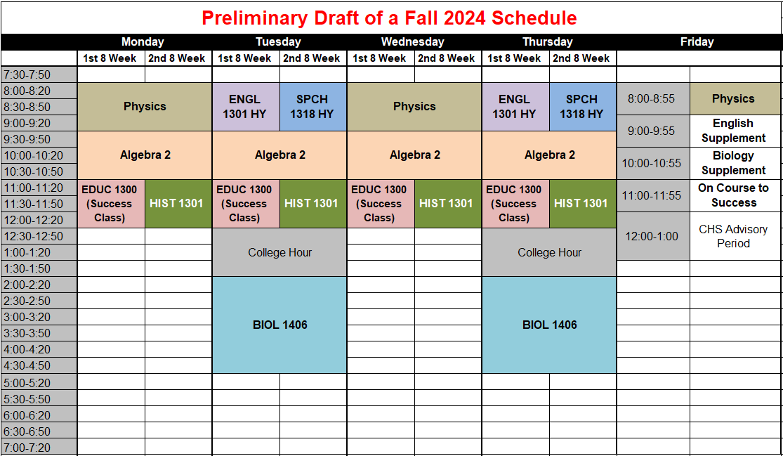
Notes:
Action items
submit interest form
choose classes
Apply Texas
Watch email for more info about testing, registration, payment and orientation

Slide 15
2022 – 2023 College Grades
54%
27%
13%
3%
3%
Notes:
Not a fit for every student
Need to be mature, self-motivated
Grades matter-need C or better in every course to avoid future issues with financial aid

Slide 16
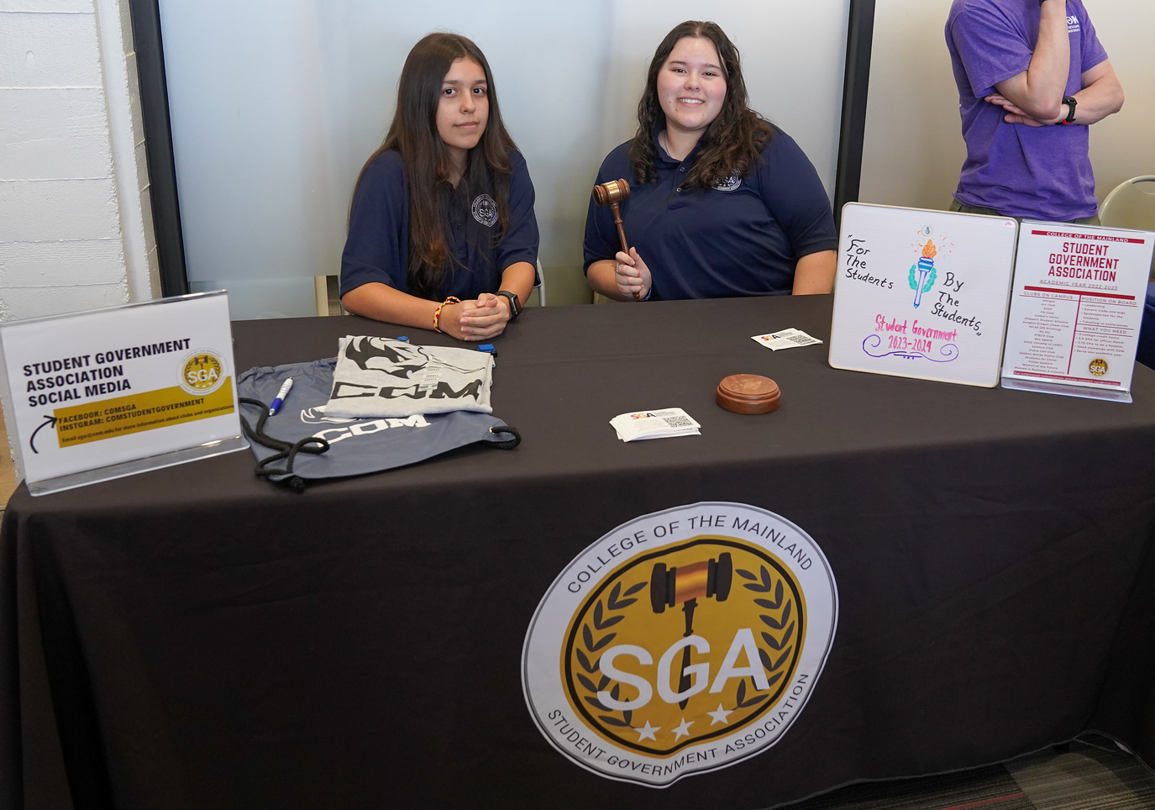
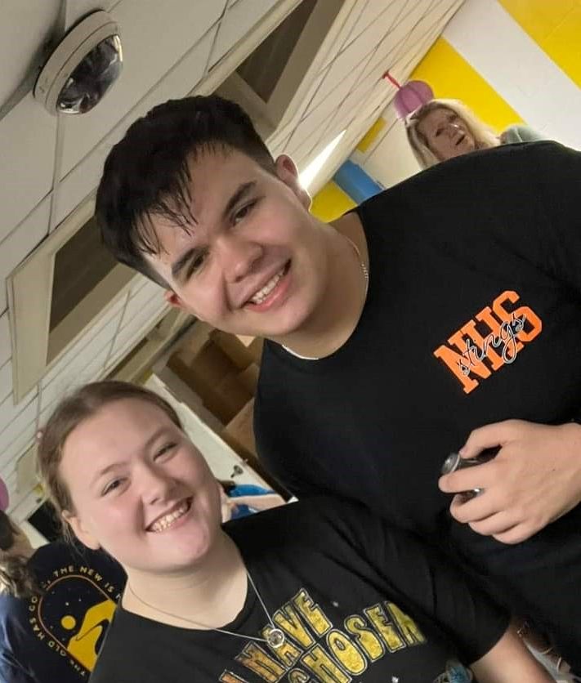
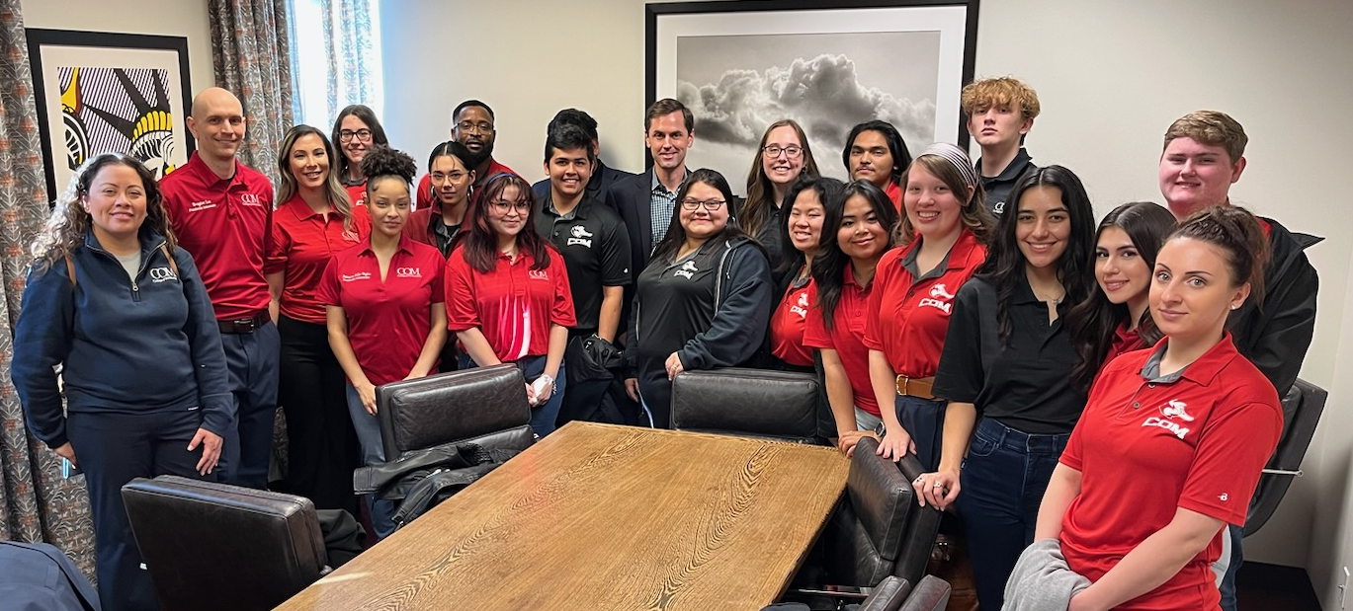
Other Components
  College Workshops/Seminars
  Employability Skills
  Portfolios
  CHS Success Class
  Extra-curricular Activities
  University, educational, community events
  Nu Psi – CHS Club at COM
Notes:
Not a fit for every student
Need to be mature, self-motivated
Grades matter-need C or better in every course to avoid future issues with financial aid

Slide 17
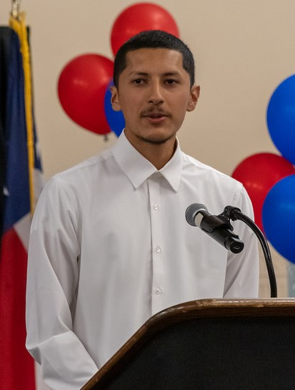
Critical Success Factors
High Academic Standards
Maturity
Self-Motivation
Responsibility
Goal Oriented

Slide 18
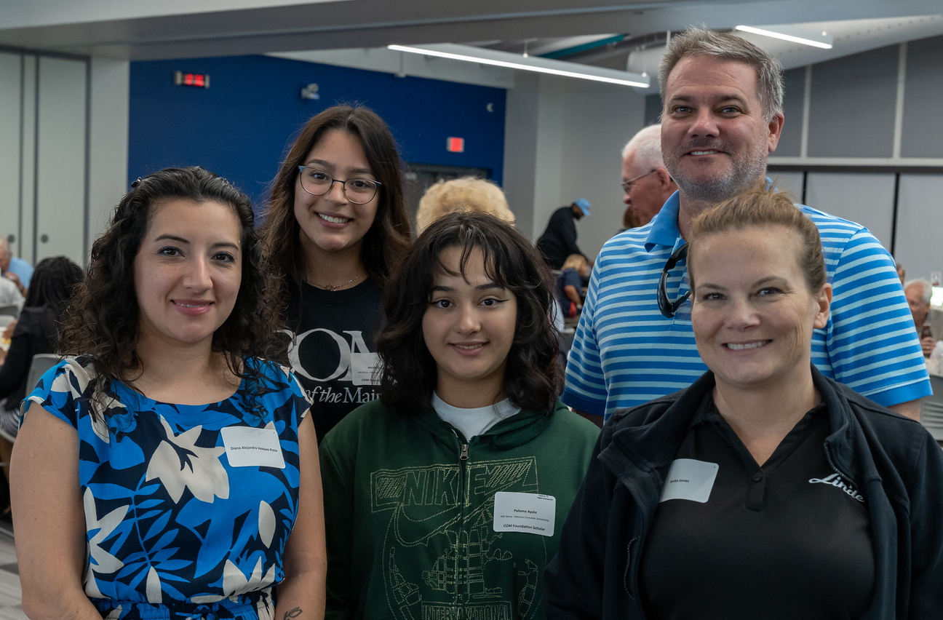
F.A.S.T. Scholarship
Students who qualified for the National Free/Reduced lunch program in any of the previous four academic years are eligible for the scholarship.
Those who qualify will not be charged for tuition, fees, textbooks or supplies.
COM will confirm student eligibility. No need to apply.
Notes:
Typical courses, may vary by school and by student
Only core curriculum courses
Courses should transfer to publicly funded universities in state

Slide 19
Opening Doors Promise Scholarship
What is it?
The Opening Doors Promise Scholarship is a “last-dollar” scholarship opportunity that covers the cost of tuition and fees for any eligible graduating high school student pursuing full-time studies at COM.
Participating students can earn an associate degree or complete a workforce training certificate program.
Participating Communities
Texas City
La Marque
Hitchcock
Santa Fe
Dickinson
Notes:
Typical courses, may vary by school and by student
Only core curriculum courses
Courses should transfer to publicly funded universities in state

Slide 20
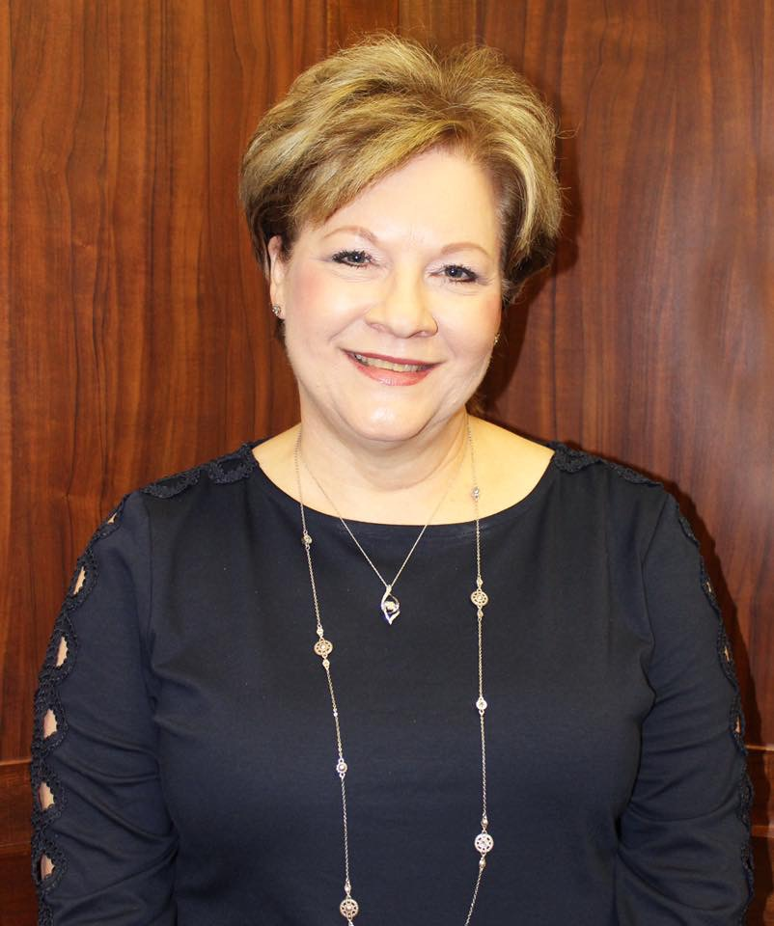
Participation of Dickinson ISD students in Collegiate High School continues to increase each year. Students' complete courses at College of the Mainland that meet high school requirements and earn college credit at the same time. Many of our students graduate with an Associate of Arts degree before they receive their high school diploma. Collegiate High School provides our students with the challenge of college-level work, and it provides guidance and support to help students transition to college life. In addition, students and parents save a substantial amount of money on tuition because of our partnership with College of the Mainland.
Carla Voelkel
Superintendent
Dickinson ISD

Slide 21
CHS Application:
www.com.edu/chs (link is towards the bottom on left side)
Sandi Belcher
Director
409-933-8158
Contact Information
TSIA2 Practice Test Sites:
https://tsia2.pearsonperspective.com
Ramona
Wadding
Administrative Assistant
409-933-8169
Notes:
Explain steps and how they will be notified along the way
Use an email that will be checked regularly on the interest form
HS approves courses that can fill HS grad requirements.
Orientation dates will be provided. Will hold orientation throughout the summer.

